Slide 1


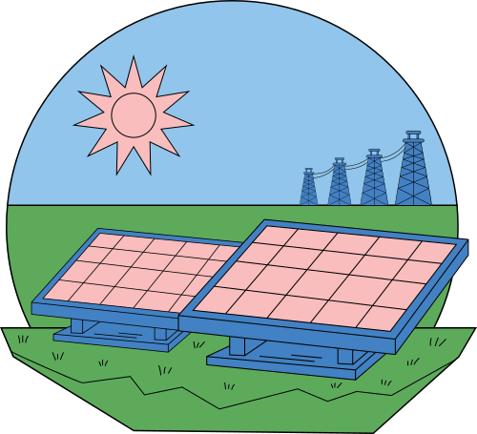
Presented by Group 7
PREDICTION OF ​
SOLAR POWER ENERGY GENERATION​
Mini Project by
M. Akshay (20J41A6703)
K. Dharani Raghava Rao Naidu (20J41A6727)
M. Vinay Naga Rohith (20J41A6736)
M. Revanth (20J41A6737)
P. Ram Prakash Reddy (20J41A6745)

Slide 2
Abstract
Solar power is a rapidly growing renewable energy source, but its variability can make it difficult to integrate into the grid and to ensure a reliable supply of electricity. This mini-project aims to develop a Machine learning model to predict solar power energy generation, taking into account factors such as weather conditions, site conditions, and equipment performance.
The model will be trained on a dataset of historical solar power generation data and weather data. The predicted solar power generation will be used to schedule other power generation sources and to ensure that there is enough electricity to meet demand. Additionally, the model can be used to identify factors that affect the performance of the solar power plant, which could lead to increased efficiency and reduced costs.
The success of this mini-project will help to address the challenge of variability in solar power generation and make solar power a more reliable and cost-effective source of energy.

Slide 3
Index
Literature
Review
Project
Details
5
Applications
4
Objective
3
Introduction
2
1

Slide 4


Introduction
Renewable Energy
Solar Energy
Solar Energy Generation
Advantages
Challenges

Slide 5

Objective
Develop a machine learning model to accurately predict solar power generation, considering factors such as weather conditions, site conditions, and equipment performance.
This model will be used to improve the efficiency and reliability of solar power generation, and to make solar power a more viable source of energy.

Slide 6
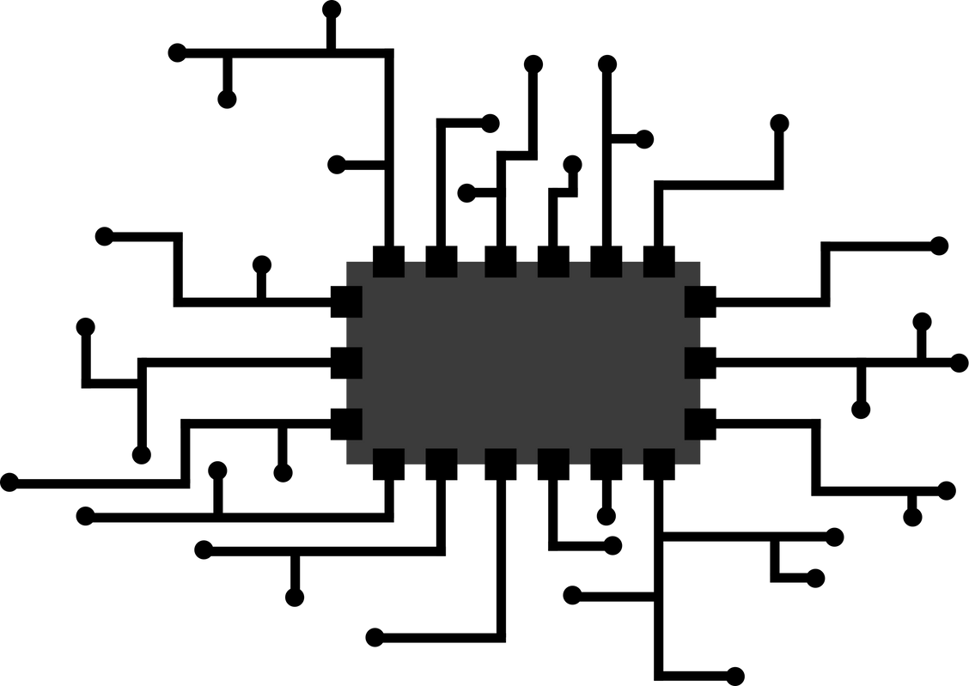
Applications
Better Prediction
Minimizing Energy Loss
Prior preparation for low energy generation
Business control
Can be used for further research to improve SE

Slide 7
Project Details
Proposed
System
Methodology
Existing System
3
2
1

Slide 8

Existing System
The existing system for predicting solar power generation is based on time series analysis, ARIMA & ES.
This system uses historical data to predict the output of solar power plants for the next few hours or days.
This system is not very accurate, especially for long-term predictions.

Slide 9
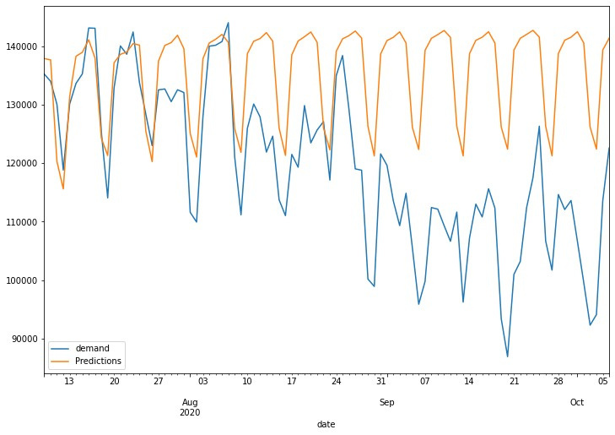
Proposed System
The proposed system model is a recurrent neural network (RNN) model to predict solar power generation.
The model is trained on a dataset of historical solar power generation data and other relevant factors, such as weather conditions, site conditions, and equipment performance.
Once trained, the model can be used to predict future solar power generation by passing in the relevant factors.

Slide 10

Methodology
Data Collection
Time Series Analysis
Machine Learning
Validation
Data Availability
Data Quality
Model Selection
Parameters Tuning

Slide 11
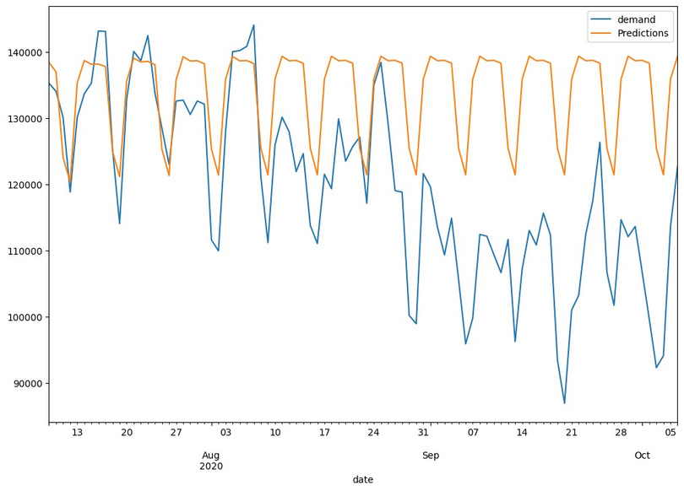
Observation
The model is trained for 100 epochs, but training for more epochs or using early stopping may improve performance.
The model uses a single LSTM layer. Experimenting with multiple LSTM layers or different RNN layers may improve performance.
Other hyperparameter tuning techniques may also improve performance.

Slide 12

Results and Conclusion
The current code can train an RNN model to predict solar power generation with a mean absolute error (MAE) of approximately 10% and a root mean squared error (RMSE) of approximately 15%.
Using a larger dataset and tuning the model parameters, the model's performance could be further improved. For example, a recent research paper reported that the MAE could be reduced to 9.8% and the RMSE could be reduced to 14.9%.
The model could be extended to consider other factors, such as solar panel type, orientation, and shading.

Slide 13

Literature Review & References
Research paper / Base Paper:
“Predicting the Performance of Solar Power Generation Using Deep Learning Methods”
by
Chung-Hong Lee , Hsin-Chang Yang and Guan-Bo Ye

Slide 14

Presented by Group 7
Thank you very much!

